Slide 1
REMOTE SENSING
Prepared by –
GROUP :- 1 (ME: B)

Slide 2
Introduction
What is Remote Sensing all about?
As you would see ‘Remote’ stands for Far away and ‘Sensing’ stands for Observing or gathering information.
Thus REMOTE SENSING means acquiring information of objects from a distance

Slide 3
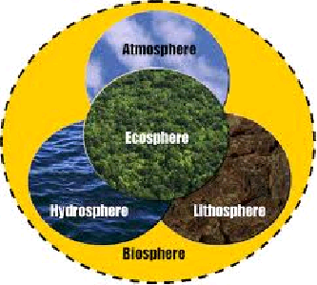
Basic concepts
Lithosphere
Biosphere
Remote Sensor
Reflecting surfaces

Slide 4
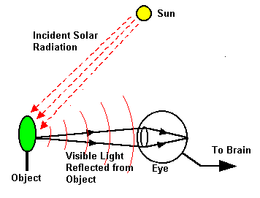
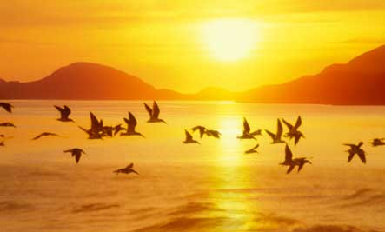
SOME DAILY EXAMPLES OF REMOTE SENSING

Slide 5
HISTORY OF REMOTE SENSING

Slide 6
Where Did remote sensing come from?
1858 Balloonist G.Tournachon made photographs of paris from his balloon.
Systematic aerial photography developed for military and reconnaissance purposes beginning in World War I and reaching a climax during the Cold War
Artificial satellites in the latter half of the 20th century

Slide 7
WORKING OF REMOTE SENSING

Slide 8
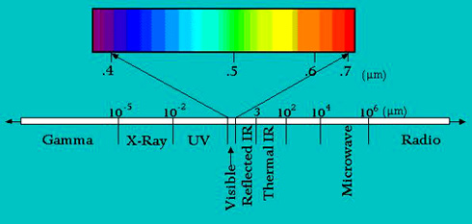
REMOTE sensing is the science of studying an area or object without actually coming into contact with it. All objects on the earth emit electromagnetic energy. This energy includes not only visible light but also other radiations in the electromagnetic spectrum. The portion that is visible to the human eye is confined to wavelengths ranging from 0.4 micrometre (blue) to 0.7 micrometre (red).

Slide 9
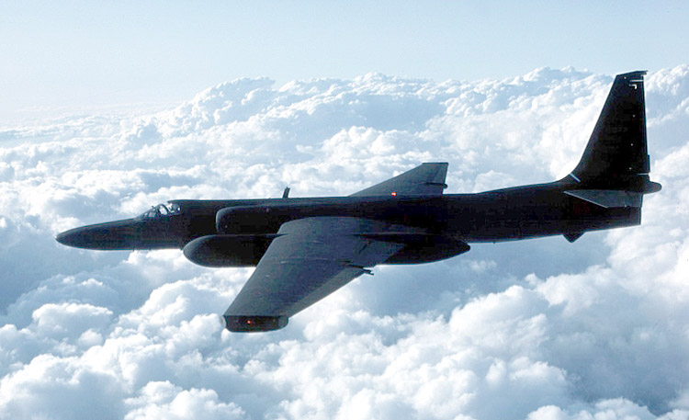
Aircrafts and Satellites are the common platforms used for remote sensing.
Collection of data is carried out with highly sophisticated sensors
Thus , remote sensing includes all methods of obtaining pictures or other forms of electromagnetic records of the Earth’s surface from a distance,their processing and interpretation.
TR-1 Survelliance aircraft used for remote sensing

Slide 10
TYPES OF REMOTE SENSING

Slide 11
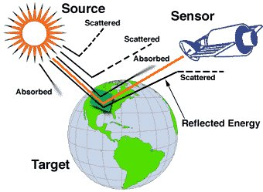
Passive Remote Sensing
It uses sun as source of EM energy and records the energy that is naturally radiated and reflected from the objects.
In this system photographs are taken on a clear bright day.

Slide 12
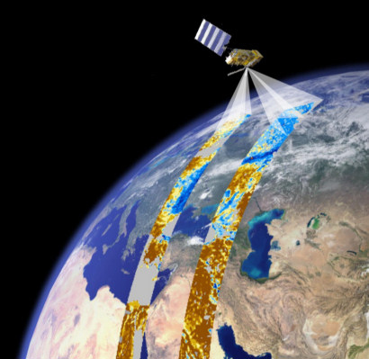
Active Remote Sensing
It uses its own source of EM energy,which is directed towards the object and return energy is measured.
A system which utilizes man-made sources of energy for data collection is called active system.

Slide 13
APPLICATIONS OF REMOTE SENSING

Slide 14
AGRICULTURE
Crop statistics,management system analysis,horticulture
FORESTRY
Forest area,types and density,biomass,grassland
ENVIRONMENT
Impact analysis,wetlands,pollution,abatement
MARINE APPLICATION
Potential fishing gene,forecast modeling,primary,productivity
URBAN ENVIRONMENT
Road development planning,route analysis
GEOLOGY
Mine targeting,oil exploration mapping,groundwater studies

Slide 16
THANKYOU

